Slide 1
Unit 2. Structure and function of the nervous system: Molecular, cellullar, synaptic, and circuit levels.
2.1. The cells of the nervous system
2.2. Resting and action potential
2.3. Synaptic transmission
What is a synapse?
Types of synapses
Transmission of information in chemical synapses
2.4. Synaptic plasticity

Slide 2
Recommended readings:
https://www.khanacademy.org/science/biology/human-biology/neuron-nervous-system/a/the-synapse
https://www.jove.com/es/science-education/10997/the-synapse?list=ZZKjFF1X

Slide 3
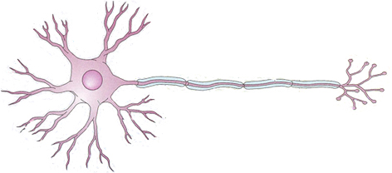
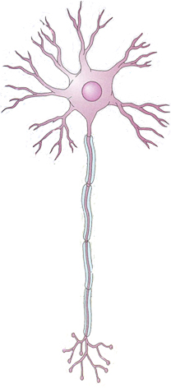
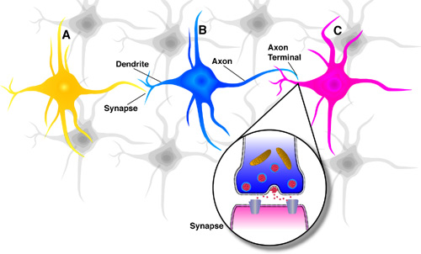
What is a synapse and which are their main features
Information from one neuron flows to another neuron across a synapse
Synapses include structural components of the two neurons that are communicating, as well a small gap between them

Slide 4
What is a synapse and which are their main features
Synaptic cleft
Postsynaptic ending or terminal
Presynaptic ending or terminal (presynaptic bouton)

Slide 5
What is a synapse and which are their main features
Kinds of synapses: According to the way that the information is conveyed
Electrical synapses Chemical synapses
The information conveyed consists in a change in membrane potential (an electrical signal)
The information is conveyed by means of a chemical Messenger (a neurotransmitter)
High plasticity. They allow learning and memory and the capacitiy to adapt to changing environments
They allow quick innate responses, but lack plasticity and cannot sustain learning

Slide 6
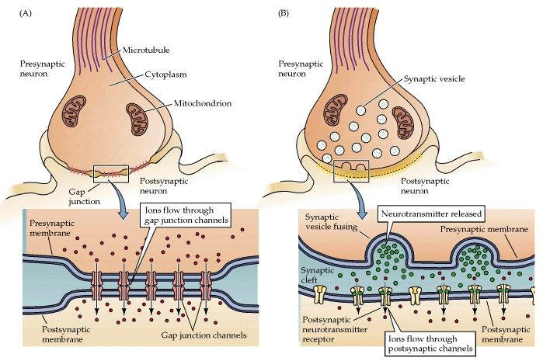
What is a synapse and which are their main features
Electrical synapse
Chemical synapse

Slide 7
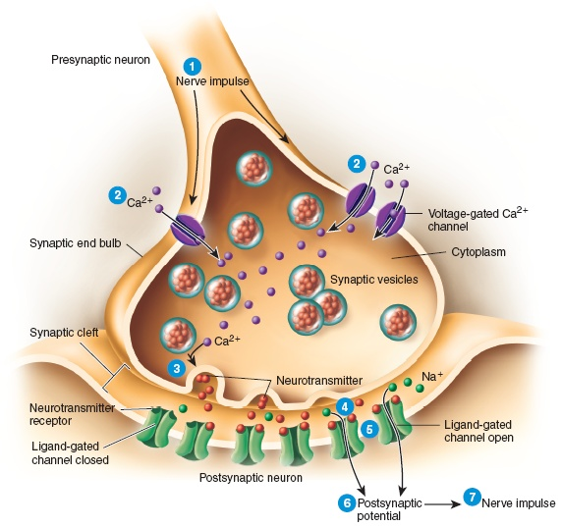
What is a synapse and which are their main features
Chemical synapses
vesicles
Synaptic cleft
mitochondria
postsynaptic density contains receptors for neurotransmitters and ligang-gated ion channels
Active zone: Part of presynaptic ending where the neurotransmitter can be released
Postsynaptic ending
Presynaptic ending (axon terminal)

Slide 8
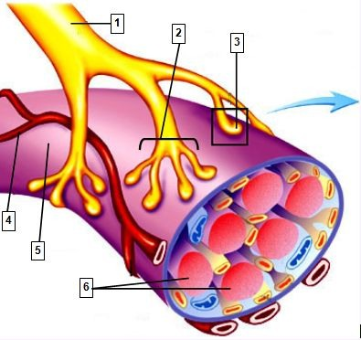
What is a synapse and which are their main features
Kinds of synapses: according to the cells involved
Synapses between two neurons
Axon terminal of a motor neuron
Synapse between a motor neuron and a muscle cell (Neuromuscular junction)
Muscle fibers (muscle cells)

Slide 9
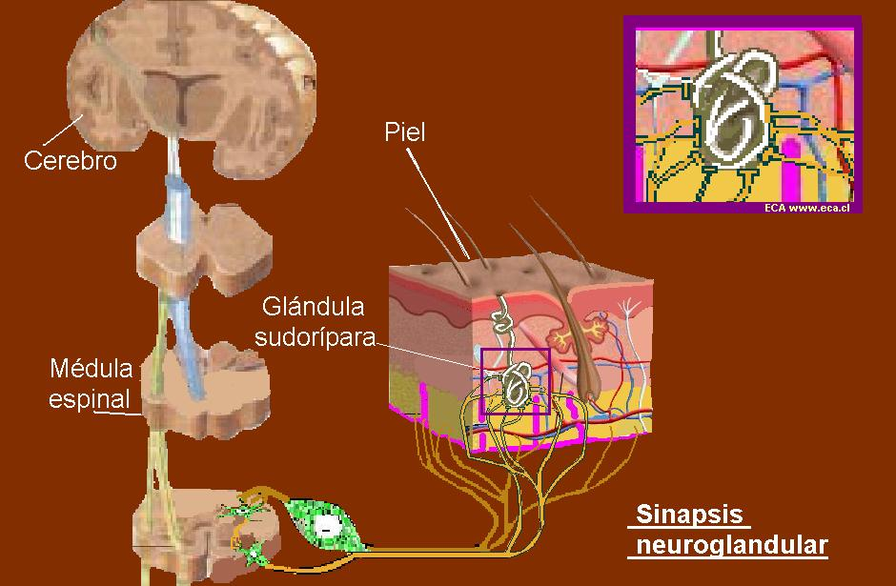
What is a synapse and which are their main features
Kinds of synapses: according to the cells involved
Synapse between a neuron and a glandular cell
(neuroglandular junction)
http://eca-ensenanzamedia-biologia.blogspot.com.es/2008/09/tipos-de-sinapsis.html

Slide 10
What is a synapse and which are their main features
Kinds of synapses: according to the contact site
Axosomatic synapse

Slide 11
What is a synapse and which are their main features
Kinds of synapses: according to the contact site
Axodendritic synapse

Slide 12
What is a synapse and which are their main features
Kinds of synapses: according to the contact site
Axoaxonic synapse

Slide 13
What is a synapse and which are their main features
Kinds of synapses: According to the postsynaptic effects
Excitatory synapses: The postsynaptic response consists in a depolarization
Inhibitory synapses: The postsynaptic response consists in a hyperpolarization
They facilitate action potential generation in the postsynaptic neuron
They make it more difficult for the postsynaptic neuron to fire

Slide 14

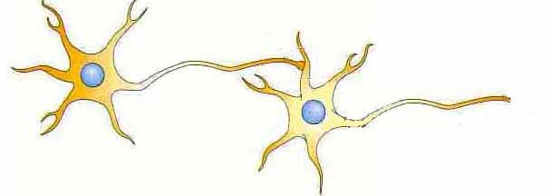
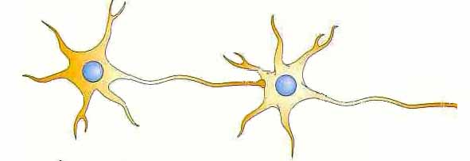

What is a synapse and which are their main features
Kinds of synapses: According to the postsynaptic effects
Excitatory synapses
They are usually axodendritic
Inhibitory synapses
They are usually axosomatic
https://www.jove.com/es/science-education/12182/excitatory-and-inhibitory-effects-of-neurotransmitters?list=ZZKjFF1X

Slide 15
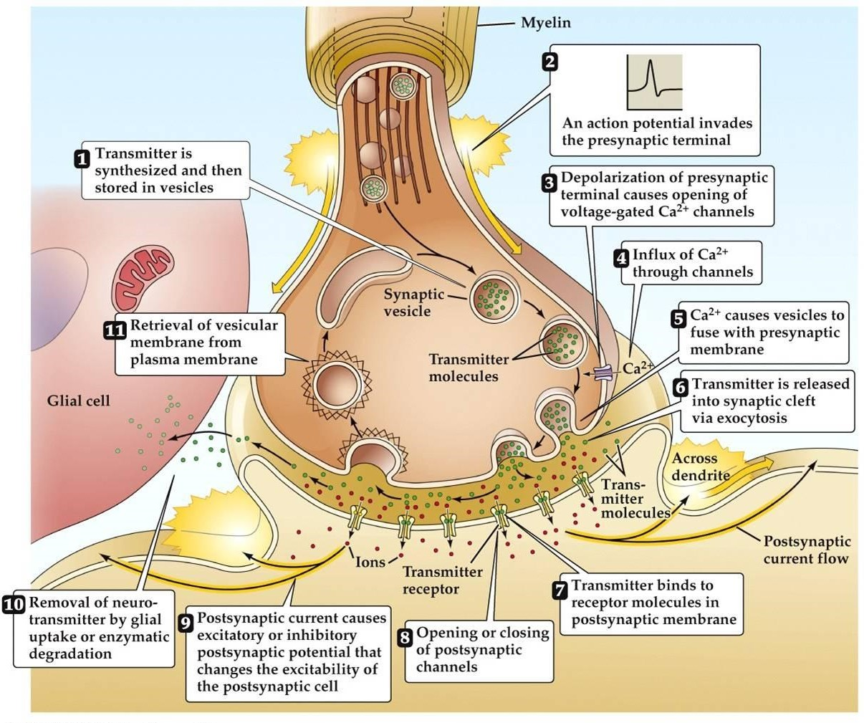
Basic mechanisms of chemical synaptic transmisión: An overview

Slide 16
Basic mechanisms of chemical synaptic transmisión
Neurotransmitter release
Under physiologic conditions, neurotransmitter release requires that the presynaptic neuron be firing, and the action potentials be conducted along the axon towards the axon terminal
https://www.youtube.com/watch?v=i-XwPjN3ZtI

Slide 17
Basic mechanisms of chemical synaptic transmisión
Neurotransmitter release
Voltage-gated Ca++ channels
When action potential reaches the axon terminal voltage-gated Ca++ channels are opened

Slide 18
Basic mechanisms of chemical synaptic transmisión
Neurotransmitter release
Voltage-gated Ca++ channels
Ca++ ions go into the axon terminal

Slide 19
Basic mechanisms of chemical synaptic transmisión
Neurotransmitter release
The inward Ca++ current triggers a set of reactions that impulse the neurotransmitter-containing vesicles towards the active zone. The vesicle membranes fuse with the presynaptic membrane and the neurotransmitter molecules are released to the synaptic cleft. This process is called exocytosis
Voltage-gated Ca++ channels

Slide 20
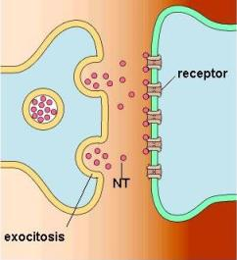
Basic mechanisms of chemical synaptic transmisión
Neurotransmitter molecules bind onto postsynaptic receptors
When neurotransmitter molecules bind onto their specific binding sites of postsynaptic receptors, certain kinds of ligand-gated channels get opened
Depending on the specific channels that are opened, the postsynaptic response will be either excitatory (depolarization) or inhibitory (hyperpolarization)
Excitatory postsynaptic potential (EPSP)
Inhibitory postsynaptic potential (IPSP)

Slide 21
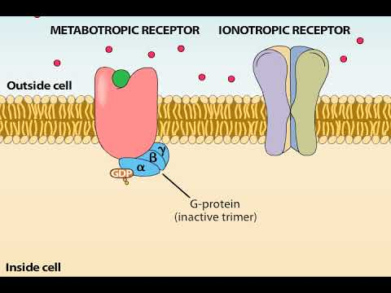
Basic mechanisms of chemical synaptic transmisión
Neurotransmitter molecules bind onto postsynaptic receptors
Kinds of postsynaptic receptors (according to the mechanism of action)

Slide 22
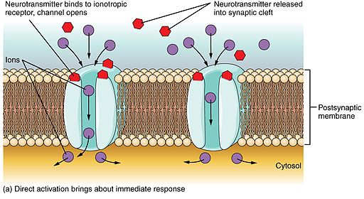
Basic mechanisms of chemical synaptic transmisión
IONOTROPIC RECEPTORS: The receptor protein has an ion channel attached to it. Binding of neurtroansmitter onto the binding site makes the channel to open and trigger either an EPSP or an IPSP (depending on the ions that cross the membrane through that channel)
Neurotransmissor
Ions
The channels attached to ionotropic receptors only open when the neurotransmitter bind to the receptor site (they are ligand-gated channels)
Depending on the channel:
EPSP
IPSP

Slide 23
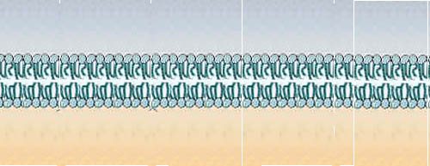
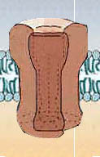
Basic mechanisms of chemical synaptic transmisión
Metabotropic receptors
Ion channel
Neurotransmitter
Enzyme
Protein kinase
P
Receptor
G protein
ADP
2nd messenger
ATP

Slide 24
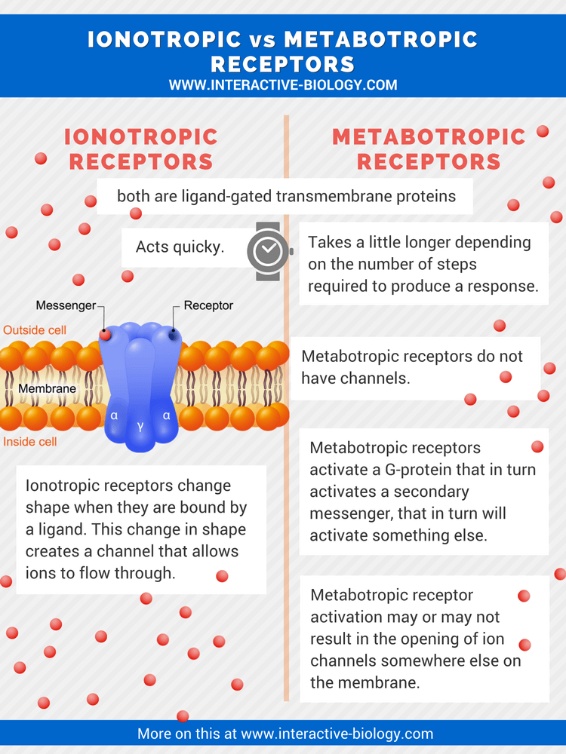
The response of ionotropic receptors is quick but usually short
The response of metabotropic receptors is slow but usually long-lasting
Metabotropic receptors can also have other effects on neurons, besides the usual function of opening channels and causing the postsynaptic response

Slide 25
Postsynaptic response
It depends on the type of channel that gets opened
Ca²⁺
EPSP
--» ligand-gated Na⁺⁻K⁺ channels
EPSP
0
IPSP
RP
-70

Slide 26
Postsynaptic response
+55
+40
EPSP
K⁺
0
Na⁺
IPSP
RP
-70
-80

Slide 27
Postsynaptic response
Ca²⁺
--»ligand-gated Cl⁻ channels
--» ligand-gated K⁺ channels
IPSP
EPSP
0
IPSP
RP
-70

Slide 28
Postsynaptic response
--»ligand-gated Cl⁻ channels
--» ligand-gated K⁺ channels
IPSP
EPSP
K⁺
0
IPSP
RP
-70
-80

Slide 29
Postsynaptic response
Ca²⁺
--»ligand-gated Cl⁻ channels
--» ligand-gated K⁺ channels
IPSP
PEP
Cl⁻
0
PIP
RP
-70
-75

Slide 30
Postsynaptic response
Certain neurotransmitters can have either excitatory or inhibitory effects, depending on the kinds of receptors and channels present in the postsynaptic ending
EPSP
IPSP

Slide 31
Postsynaptic effects: Mechanisms of synaptic integration
Spatial and temporal summation
SPATIAL SUMMATION: Summation of all EPSPs and/or IPSPs generated in different postsynaptic terminals and reaching the axon hillock at the same time, or very close in time
TEMPORAL SUMMATION: Summation of all EPSPs or IPSPs that are produced in the same postsynaptic terminal very close in time
https://www.youtube.com/watch?v=wNrszKEPUQc
https://www.youtube.com/watch?v=Pd0IQ-Nx8dM

Slide 32
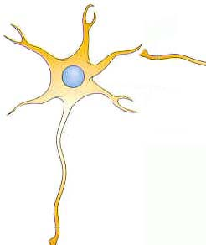
Postsynaptic effects: Mechanisms of synaptic integration
Temporal summation
0
RP
-70

Slide 33
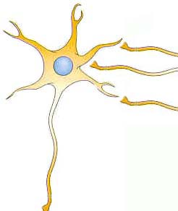
Postsynaptic effects: Mechanisms of synaptic integration
Spatial summation
0
PR
-70

Slide 34
Postsynaptic effects: Mechanisms of synaptic integration
Spatial summation
0
PR
-70

Slide 35
Postsynaptic effects: Mechanisms of synaptic integration
Spatial summation
0
PR
-70

Slide 36
Postsynaptic effects: Mechanisms of synaptic integration
Spatial summation
0
PR
-70

Slide 37
Postsynaptic effects: Mechanisms of synaptic integration
Synaptic integration takes place at the axon hillock.
The result of summation determines whether the neuron will fire or not

Slide 38
Postsynaptic effects: Mechanisms of synaptic integration
“DECISIONS” of the postsynaptic neuron
1. Will the neuron begin to fire (produce action potentials)?
2. In case it fires, which will be the spiking frequency?

Slide 39
Postsynaptic effects: Mechanisms of synaptic integration
Decision 1: Will the neuron begin to fire (produce action potentials)?
Yes, if summation leads the membrane potential to the spiking threshold
No, if otherwise

Slide 40
Postsynaptic effects: Mechanisms of synaptic integration
Decision 2: In case it fires, which will be the spike frequency (how many action potentials per second?)
The higher the depolarization induced by summation of postsynaptic potentials, the higher the frequency of action potentials

Slide 41
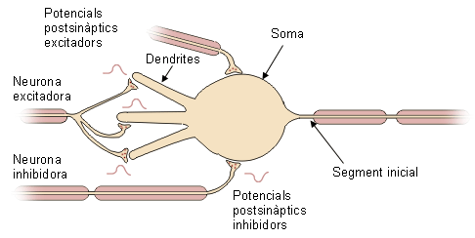
Postsynaptic effects: Mechanisms of synaptic integration
Spiking threshold of this neuron: -49 mV
+
+
-50
Summation does not reach the spiking threshold.
Action potentials are not produced
=

Slide 42
Postsynaptic effects: Mechanisms of synaptic integration
Spiking threshold of this neuron: -49 mV
+
+
+
-49
Summation reaches the spiking threshold.
Action potentials are produced
=

Slide 43
Postsynaptic effects: Mechanisms of synaptic integration
Spiking threshold of this neuron: -49 mV
+
+
+
-25
Summation gives a depolarization level higher than the spiking threshold.
A high frequency of action potentials is produced
=

Slide 44
Neurotransmitter inactivation
Enzymatic degradation: Neurotransmitter molecules are broken down by an enzyme
Reuptake: Neurotransmitter molecules are introduced again into the presynaptic terminal, or into a glial cell
Reuptake requires high-affinity active transporters (pumps) in the presynaptic membrane (or in nearby glial cells)
Reuptake is thus done againts the concentration gradient, and the transporters are specific for a given neurotransmitter

Slide 45
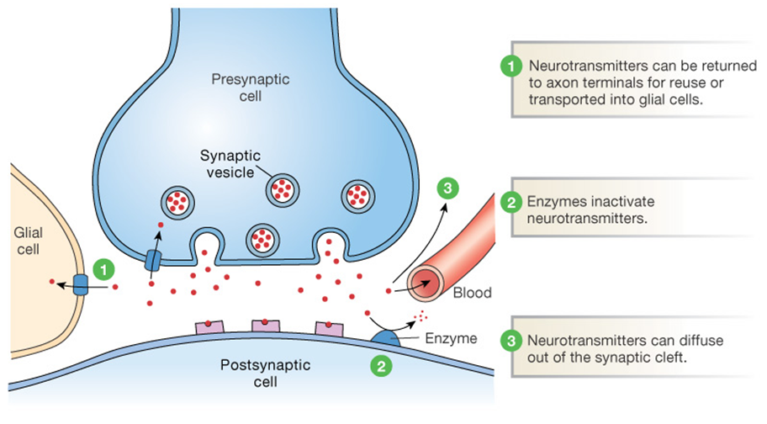
Neurotransmitter inactivation
REUPTAKE
ENZYMATIC DEGRADATION
https://socratic.org/questions/why-is-inactivation-of-neurotransmitters-important

Slide 46
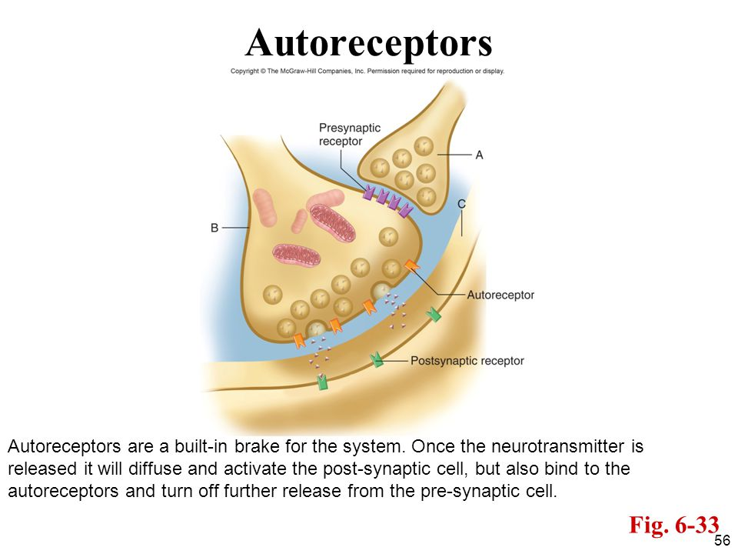
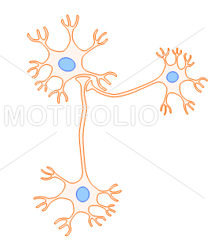
Synaptic modulation. Presynaptic receptors
Two kinds of presynaptic receptors: Autoreceptors and Heteroreceptors
HETERORECEPTORS:
Are the receptors of axoaxonic synapses
C
A
B

Slide 47
Synaptic modulation. Presynaptic receptors
AUTORECEPTORS
Are located in the synaptic terminal and act as receptors for the neurotransmitter of the own releasing neuron
AUTORECEPTORS

Slide 48
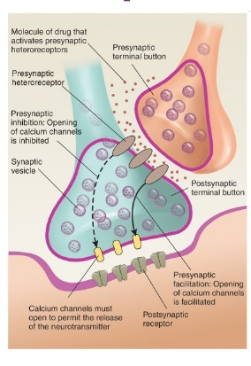
Synaptic modulation. Presynaptic receptors
Heteroreceptors can induce:
Presynaptic facilitation: Enhance the response of the “typical synapse”
Presynaptic inhibition: Reduce the response of the “typical” synapse

Slide 49
Most common neurotransmitters
GABA (Gamma amino butyric acid): It is present in every region of the central nervous system. It is always inhibitory
https://www.youtube.com/watch?v=bQIU2KDtHTI&t=1s
Glutamate (Glu) and Aspartate (excitatory aminoàcids): They are present in every region of the central nervous System. They are always excitatory
https://www.youtube.com/watch?v=29QfkTjIWHU
Acetylcholine (Ach): The cell bodies of cholinergic neurons are located only in specific regions of encephalon, as well as in the autonomous nervous system and in motorneurons. Cholinergic neurons in the encephalon have widespread effects due to their long ramified axons.
https://www.youtube.com/watch?v=6WFhhL-enlQ&t=1s
Catecholamines (Dopamine, Noradrenaline or norepinephrine, adrenaline or epinephrine)
https://www.youtube.com/watch?v=Wa8_nLwQIpg
https://www.youtube.com/watch?v=m8kthApqQys&t=7s
Serotonin
https://www.youtube.com/watch?v=Xkl_x6wC0Lg

